Slide 1
BERT: Bidirectional Encoder Representations from Transformers
https://arxiv.org/pdf/1810.04805.pdf

Slide 2
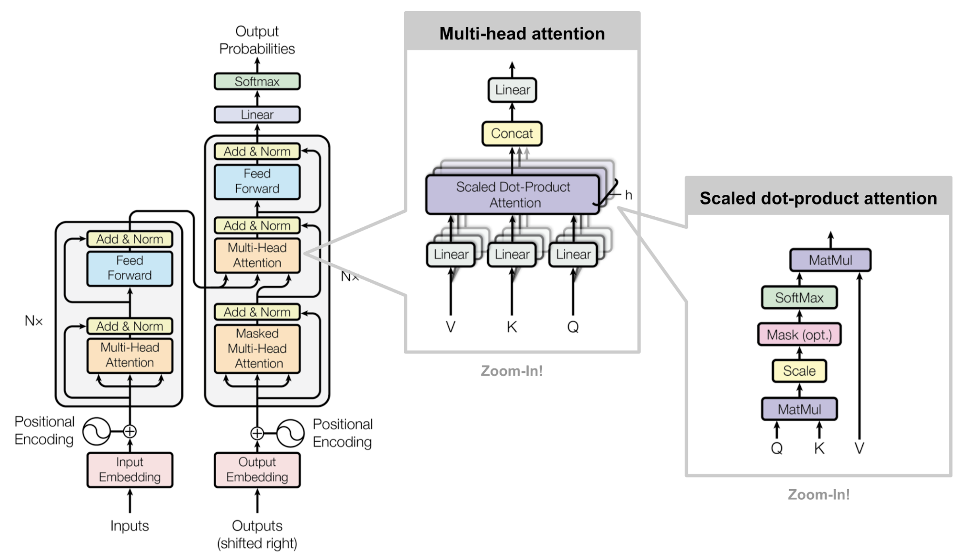

Slide 3
Contextual Representation
Rose rose to put rose roes on her rows of roses.
Problem: Word embeddings are applied in a context free manner
Solution: Train contextual representations on text corpus
Open a bank account
… on the bank of a river
[0.43, -0.51, 0.33,…]
[-0.5, -0.9, 1.4,….]
[-0.6, -0.8, 1.2,….]
Open a bank account
… on the bank of a river

Slide 4
Contextual Representation
Language models only use left or right contexts. But Language understanding is bidirectional.
Ex: The rat the cat the dog chased killed ate the malt
Why LMs are unidirectional?
Reason1: Useful for Prediction
Reason2: Words can see themselves in bidirectional encoders

Slide 5
Masked LM
Solution: Mask out K% of the input words and then predict the masked words.
K=15%
The man went to the [MASK] to buy a [MASK] of milk
Too little masking→ expensive to train
Too much masking → Not enough context
Store
bottle

Slide 6
Masked LM
Problem: masked token never seen during fine-tuining
Solution:
15% of the words to predict, but don’t replace by [MASK] 100% of time.
Instead:
80% of the time replace with [MASK]
Went to the store → Went to the [MASK]
10% of the time replace with random words
Went to the store → Went to the bottle
10% of the time, keep same
Went to the store → Went to the store

Slide 7
Next Sentence Prediction
To learn relationships between sentences, predict whether sentence B is actual sentence that proceeds sentence A, or a random sentence.
Sent-1: The man went to the store. Sent-1: The man went to the store.
Sent-2: He brought a bottle of milk Sent-2: penguins are flightless
Label: isNextSentence Label: notNextSentence

Slide 8
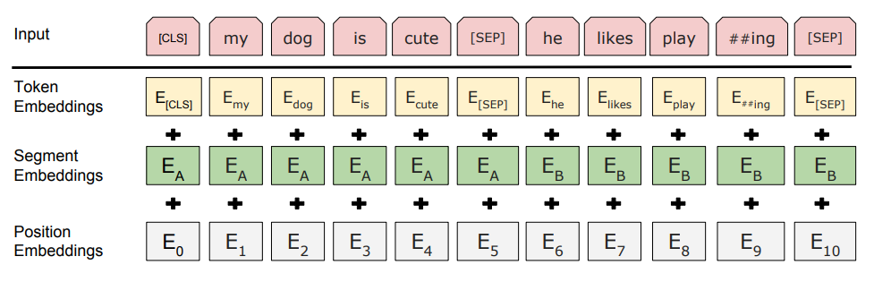
Input representation
Uses 30K word piece vocabulary
Each token is sum of the 3 embeddings

Slide 9
Model Details
Data: Wikipedia (2.5B) words, Book Corpus (800M) words.
Batch Size: 131,072 words (1024 sequence *128 length or 256 sequence * 512 length)
Training Time: 1M steps (~40 epochs)
Optimizer: AdamW, 1e-4 learning rate, linear decay
BERT-Base: 12 layer, 768-hidden states, 12-head
BERT-Large: 24-layer, 1024 hidden states, 16-head
Trained on 4x4 or 8x8 TPU slice for 4 days

Slide 10
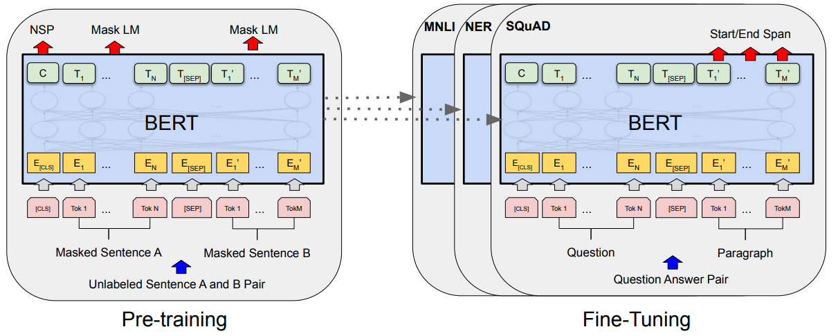
Fine-Tuining Procedure

Slide 11
Input representation
Uses 30K word piece vocabulary
Each token is sum of the 3 embeddings

Slide 12
Fine-Tuining Procedure

Slide 13
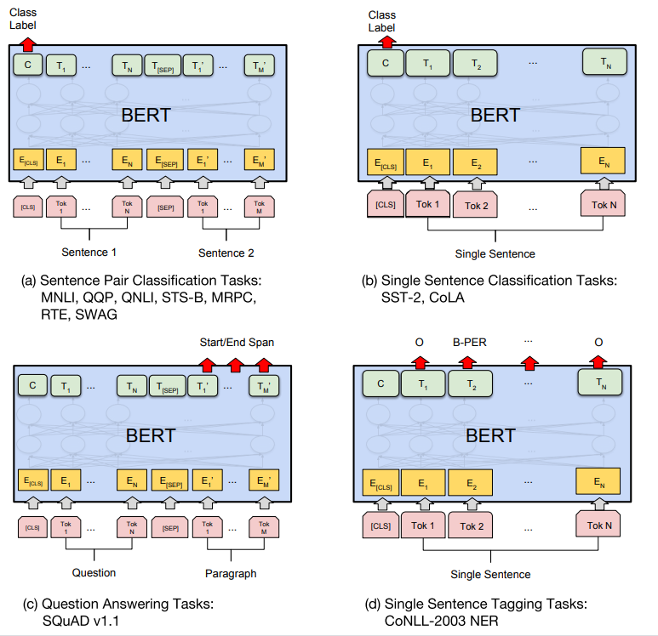

Slide 14
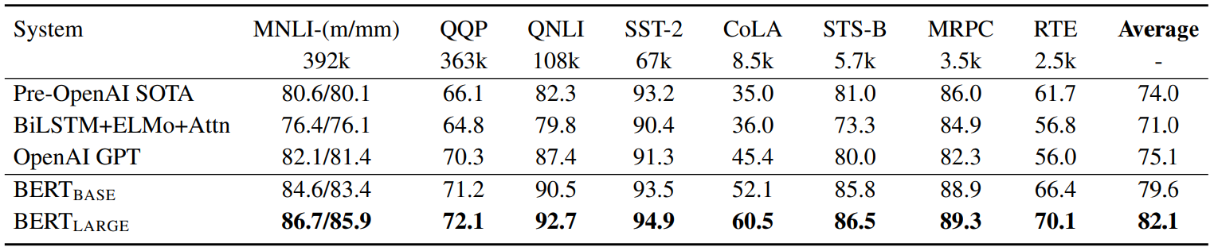
https://gluebenchmark.com/leaderboard

Slide 15
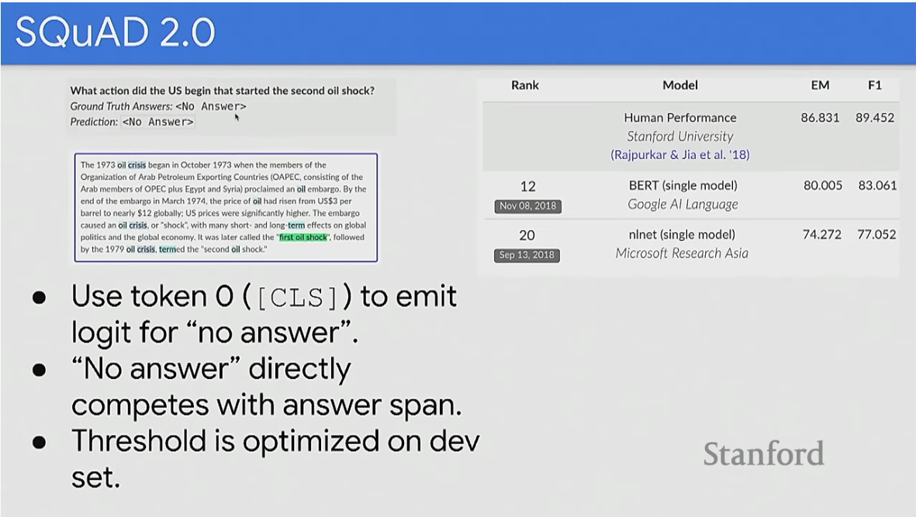

Slide 16
POST BERT Pre-training Advancements

Slide 17
RoBERTa
A Robustly Optimized BERT Pretraining Approach. (FaceBook, 2019)
Trained BERT for more data
BOOKCORPUS (16GB)
CC-NEWS (76GB)
OPENWEBTEXT (38GB)
stories (31 GB)
More epoch
Dynamic Masking
https://arxiv.org/pdf/1907.11692.pdf

Slide 18
RoBERTa
Static vs. Dynamic Masking
BERT relies on randomly masking and predicting tokens.
The original BERT implementation performed masking once during data preprocessing, resulting in a single static mask.
To avoid using the same mask for each training instance in every epoch, training data was duplicated 10 times so that each sequence is masked in 10 different ways over the 40 epochs of training.
Thus, each training sequence was seen with the same mask four times during training.
In dynamic masking we generate the masking pattern every time we feed a sequence to the model.

Slide 19
XLNet: Generalized Autoregressive Pretraining for Language Understanding
Relying on corrupting the input with masks, BERT neglects dependency between the masked positions and suffers from a pretrain-finetune discrepancy.
Enables learning bidirectional contexts by maximizing the expected likelihood over all permutations of the factorization order and
Autoregressive formulation.
Novelty-1: Relative position Embedding
Novelty-2: Permutation Language Modelling
https://arxiv.org/pdf/1906.08237.pdf

Slide 20
XLNet
Two kind of language model
Autoregressive:
Each token can look at the kind of previous ones in the sequence
Autoencoding:
is what BERT does.

Slide 21
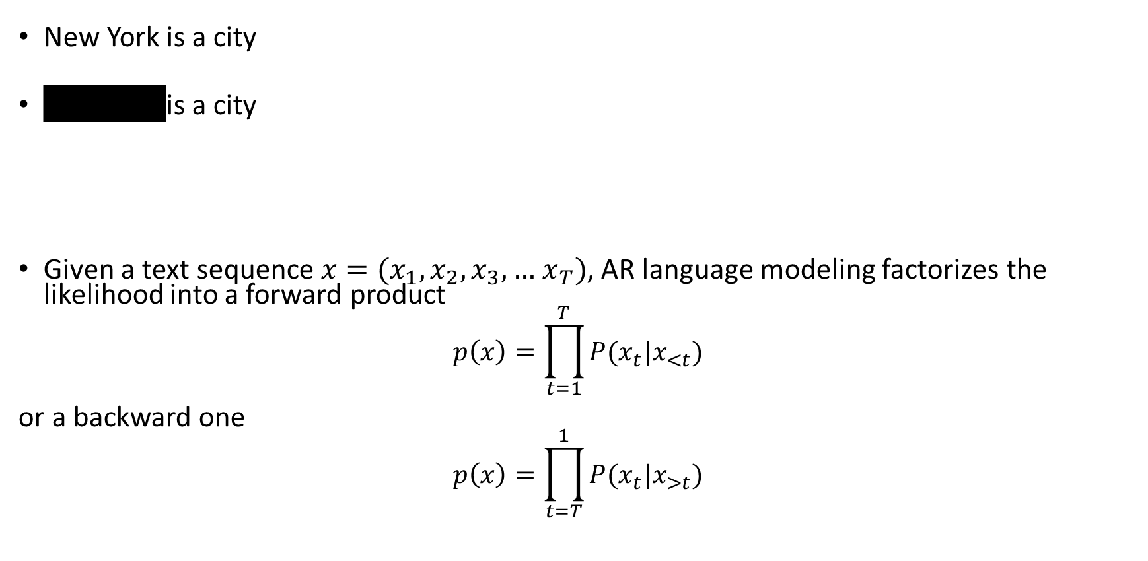
XLNet
New York is a city
New York is a city
Given a text sequence $x=(x_{1},x_{2},x_{3},…$ $x_{T})$, AR language modeling factorizes the likelihood into a forward product
$$p\left(x\right)=\prod_{t=1}^{T}{P(x_{t}|x_{<t})}$$
or a backward one
$$p\left(x\right)=\prod_{t=T}^{1}{P(x_{t}|x_{>t})}$$
$$Τ_{Bert}=\log{P\left(New \right|is a city)+log⁡P(York|is a City)}$$
$$Τ_{XLNet}=\log{P\left(New \right|is a city)+log⁡P(York|New,is a City)}$$

Slide 22
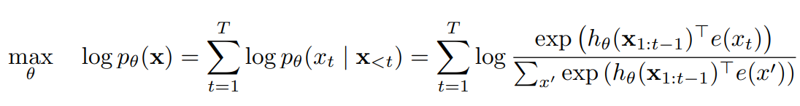
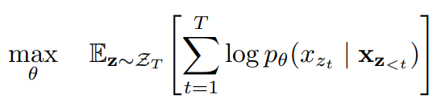
XLNet: Formalization
Autoregressive
BERT

Slide 23
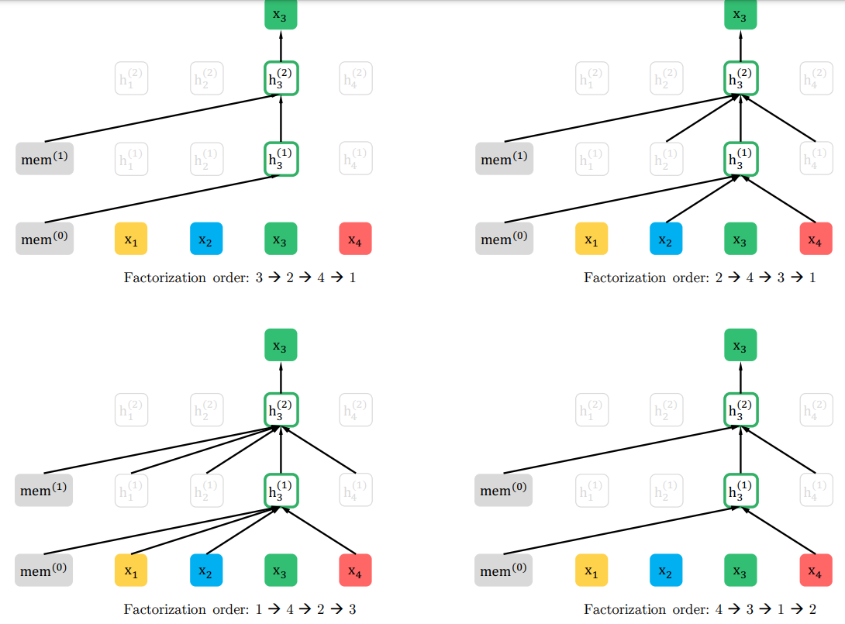
XLNet: Permutation Language Modelling

Slide 24
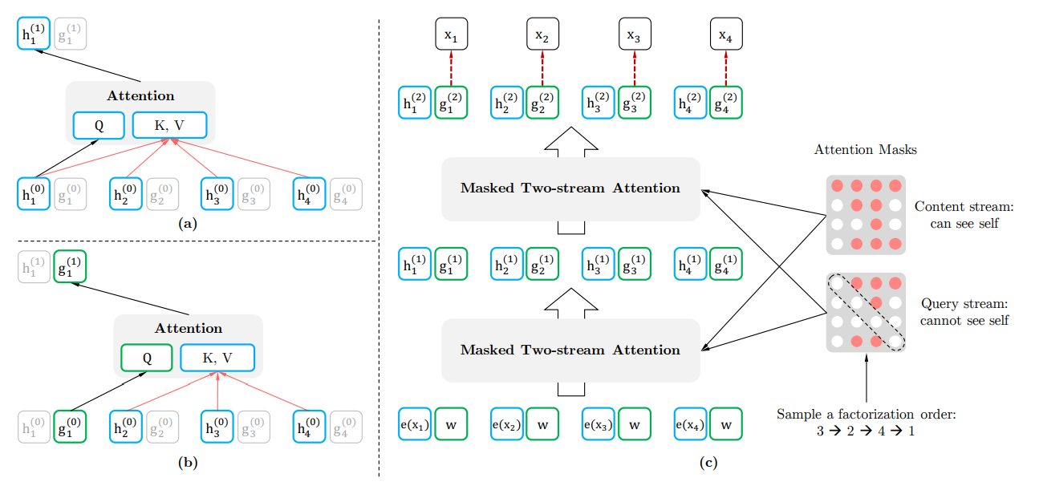
XLNet

Slide 25
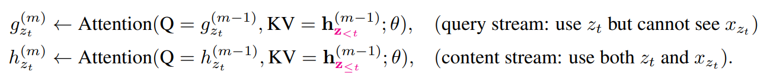
XLNet

Slide 26
ALBERT: A lite BERT for self supervised learning of language representation (2019)
Novelty: Factorized Embedding parameterization
Use small embedding size (say 128) and then project it to transformer hidden size (say 1024) with parameter hidden matrix
Cross Layer Parameter sharing
1024
X
100K
128
X
100K
Vs
X
1024
X
128

Slide 27
T5 (2019)
Exploring the limits of transfer learning with a unified Text-to-Text Transformer.
Ablated many aspects of pre-training
Model size
Amount of training data
Domain/Cleanness of training data
Pre-training objective details
Ensambling
Fine tuining
Multi-task

Slide 28
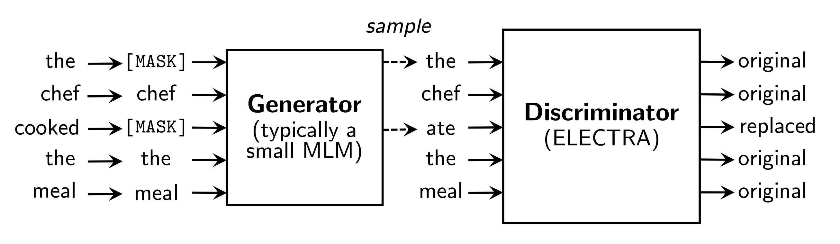
Electra- 2020
Pre-training Text Encoder as Discriminators Rather than Generators
Train models to discriminate locally plausible text from real text

Slide 29
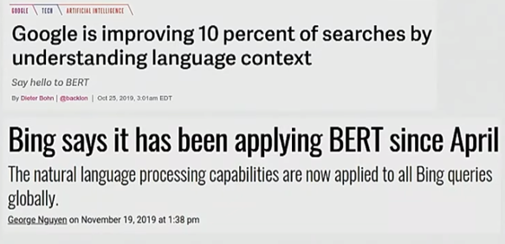
Applying models to production Services
BERT and other pre-trained language models are extremely large and expensive
How are organizations apply them to low latency production services?

Slide 30
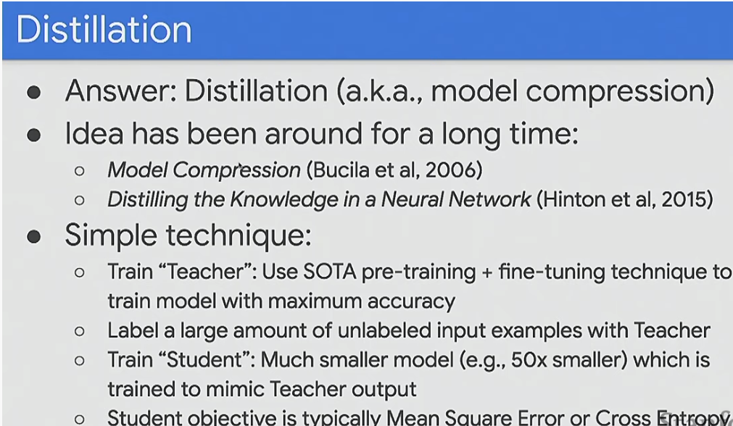

Slide 31
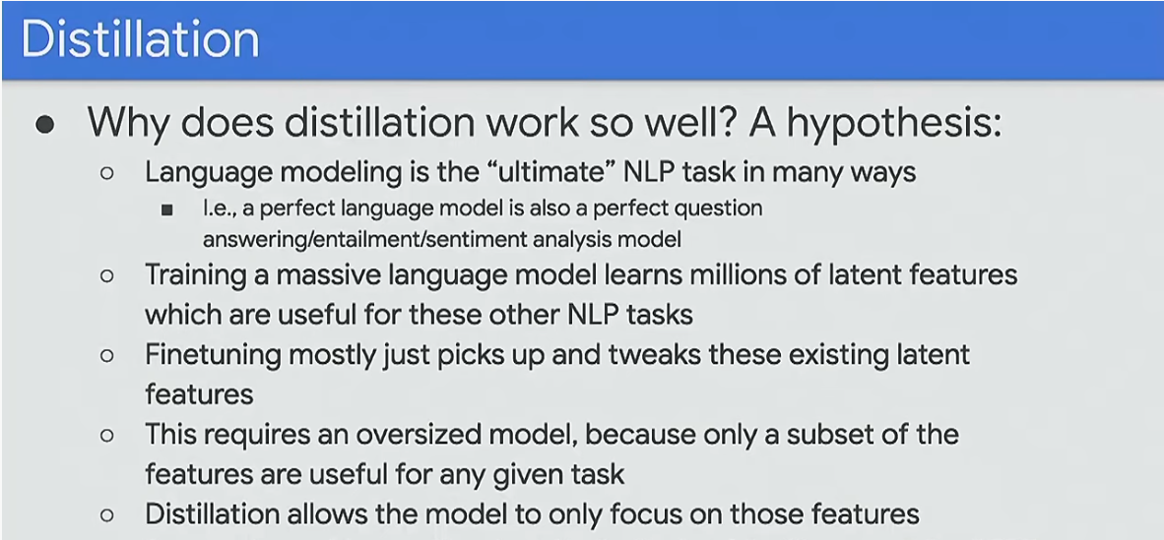

Slide 32
